Slide 1


Algorithm Efficiency and Pattern

Slide 2
The “Best” Algorithm
There are usually multiple algorithms to solve any particular problem.
The notion of the “best” algorithm may depend on many different criteria:
Structure, composition, and readability
Time required to implement
Extensibility
Space requirements
Time requirements

Slide 3
Time/Space Analysis
Example:
Algorithm A runs 2 minutes and algorithm B takes 1 minutes and 45 second to complete for the same input.
Is B “better” than A? ➠ Not necessarily!:
We have tested A and B only on one (fixed) input set. Another input set might result in a different runtime behavior.
Algorithm A might have been interrupted by another process.
Algorithm B might have been run on a different computer.
A reasonable time and space approximation should be machine-independent.

Slide 4
Big-O notation
Wiki : Big O notation is a mathematical notation that describes the limiting behaviour of a function when the argument tends towards a particular value or infinity
It is used to describe the worse case, or ceiling of growth for an algorithm or a function.
It is a simplified analysis of an algorithm’s efficiency/ complexity.
Asymptotic analysis
It focuses on basic computing steps

Slide 5
Big-O notation : General rules
Ignores the constant coefficient
n, 2n, 5n, ... O(n)
Functions/algorithms with “higher growth rate” dominate others
O(1)<O(logn)<O(n)<O(nlogn)<O(n²)<O(2^{n})<O(n!)

Slide 6
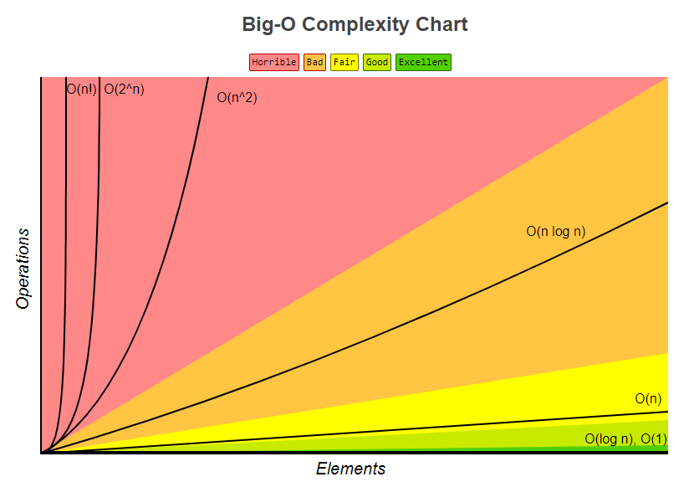
Big-O notation : General rules
Ignores the constant coefficient
n, 2n, 5n, ... O(n)
Functions/algorithms with “higher growth rate” dominate others
O(1)<O(logn)<O(n)<O(nlogn)<O(n²)<O(2^{n})<O(n!)
Figure from bigocheatsheet.com

Slide 7
Big-O : Constant time, O(1)
Notation: O(1)
x = 3*(5+12)
x is independent from any input or additional variables
We call such complexity, constant time x=3*(5+12);
y=15-2;
print x-y;
What is big-O for this code?
Total = O(1)+O(1)+O(1) = 3*O(1) => O(1)
Since constants are ignored.

Slide 8
Big-O : Linear time, O(n)
Notation: O(n)
for(int i =0; i<n; ++i)
cout<<i<<endl;
O(1) statement repeat n times. n is not a constant coefficient but it is possibly a variable.
So it is n*O(1) = O(n)

Slide 9
Big-O notation : Example
m = 3*(2+13);
for(i =0; i<n; ++i)
cout<<i<<endl;
The total time = O(1)+O(n)...= O(n)

Slide 10
Big-O: Quadratic time, O(n²)
Two for loops
for(i =0; i<n; ++i)
for(j =0; j<n; ++j)
cout<<i*j<<endl;

Slide 11

Big O Notation in 5 minutes
URL: https://www.youtube.com/watch?v=__vX2sjlpXU

Slide 12
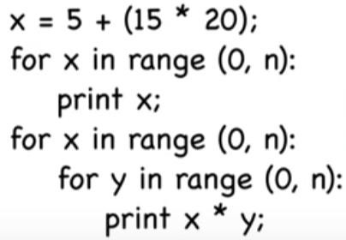
Big-O notation: exercise 1
What is the Big-O for this?
O(1)
O(n)
O(n²)
The largest run time will be the Big-O notation: O(n²)

Slide 13
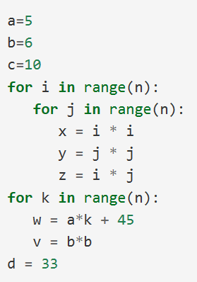
Big-O notation: exercise 2
The largest run time will be the Big-O notation: O(n²)
O(n²)
O(n)

Slide 14
What is computable?
Computation is usually modeled as a mapping from inputs to outputs, carried out by a “formal machine”, or program, which processes its input in a sequence of steps.
An “effectively computable” function is one that can be computed in a finite amount of time using finite resources.

Slide 15
Halting Problem
A problem that cannot be solved by any machine in finite time (or any equivalent formalism) is called uncomputable.
An uncomputable problem cannot be solved by any real computer.
The Halting Problem:
Given a program and its input, determine whether the program will complete or run forever.
The Halting Problem is provably uncomputable – which means that it cannot be solved in practice.
green = ON
red = amber = OFF while(true){
amber = ON; green = OFF;
wait 10 seconds;
red = ON; amber = OFF; wait 40 seconds;
green = ON; red = OFF;
}

Slide 16
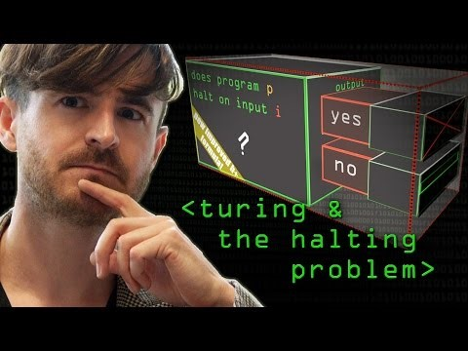
Turing and the Halting Problem
URL: https://www.youtube.com/watch?v=macM_MtS_w4

Slide 17
Algorithmic Patterns
Direct solution strategies:
Brute force and greedy algorithms
Backtracking strategies:
Simple backtracking and branch-and-bound algorithms
Top-down solution strategies:
Divide-and-conquer algorithms
Bottom-up solution strategies:
Dynamic programming
Randomized strategies:
Monte Carlo algorithms

Slide 18
Brute-force Algorithms
Brute-force algorithms are not distinguished by their structure.
Brute-force algorithms are separated by their way of solving problems.
A problem is viewed as a sequence of decisions to be made. Typically, brute-force algorithms solve problems by exhaustively enumerating all the possibilities

Slide 19
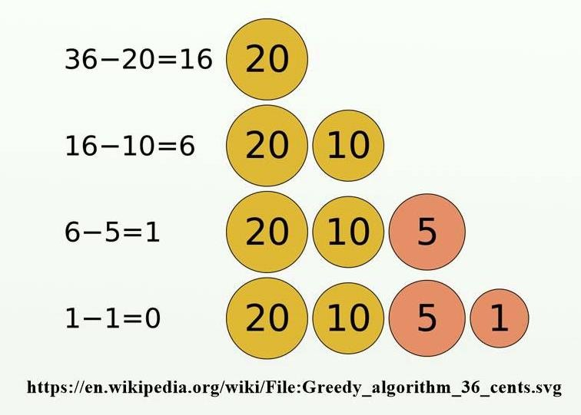
Greedy Algorithms
Greedy algorithms do not really explore all possibilities.
They are optimized for a specific attribute.
It always makes the choice that seems to be the best at that moment.
It makes a locally-optimal choice in the hope that this choice will lead to a globally-optimal solution.

Slide 20
Divide-and-Conquer
Top-down algorithms use recursion to divide-and-conquer the problem space.
This class of algorithms has the advantage that not all possibilities have to be explored.
Divide the problem into a number of subproblems that are smaller instances of the same problem.
Conquer the subproblems by solving them recursively.
Solution: Combine the solutions to the subproblems into the solution for the original problem.
Example: Binary Search, Merge Sort, Quick Sort

Slide 21
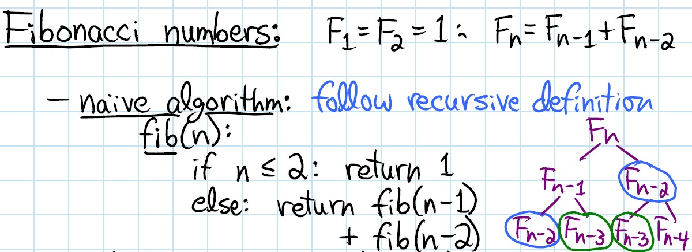
Divide-and-Conquer

Slide 22
Dynamic programming
Bottom-up algorithms employ dynamic programming.
Bottom-up algorithms solve a problem by solving a series of subproblems.
These subproblems are carefully devised in such a way that each subsequent solution is obtained by combining the solutions to one or more of the subproblems that have already been solved.

Slide 23
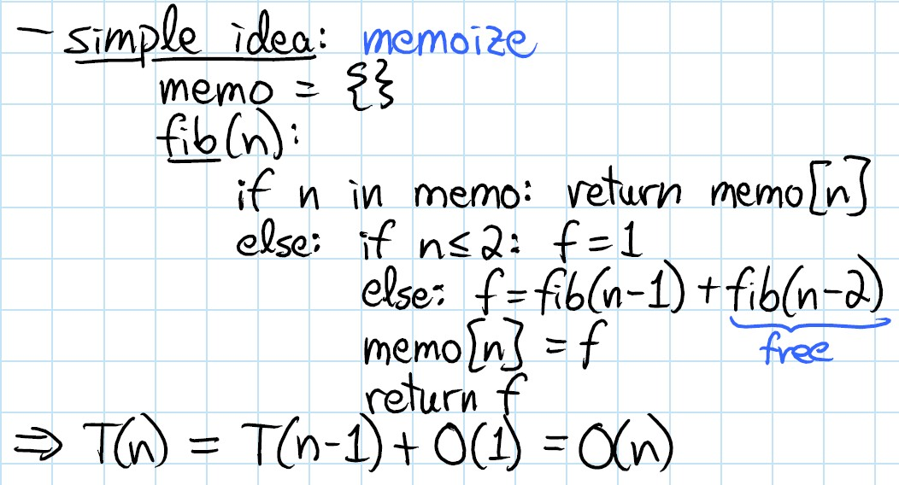
Dynamic programming

Slide 24
Difference D&C and Dynamic Programming
Divide-&-conquer works best when all subproblems are independent. So, pick partition that makes algorithm most efficient & simply combine solutions to solve entire problem.
Dynamic programming is needed when subproblems are dependent; we don’t know where to partition the problem.
Divide-&-conquer is best suited for the case when no “overlapping subproblems” are encountered.
In dynamic programming algorithms, we typically solve each subproblem only once and store their solutions. But this is at the cost of space.

Slide 25
Randomized Algorithms
Randomized algorithms behave randomly.
Randomized algorithms select elements in an random order to solve a given problem.
Eventually, all possibilities are explored, but different runs can produce results faster or slower, if a solution exists.
Example: Monte Carlo Methods, Simulation

Slide 26
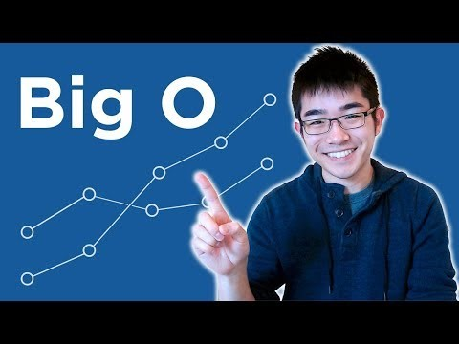
Introduction to Big O Notation and Time Complexity
URL: https://www.youtube.com/watch?v=D6xkbGLQesk

Slide 27
End of Algorithm Efficiency and Pattern
Big O Cheat Sheet:
http://bigocheatsheet.com/

